Slide 1













SINGLE PAGE PORTFOLIO APPLICATION USING REACT AND BOOTSTRAP
Student Name:S.Uma Mageshwari
Register number:222406281
NMID:5C7CBACE3DC292F8F7D40505A2CA8535
Department:B.sc Computer science with Artificial intelligence
College:SRM ARTS AND SCIENCE COLLEGE
University:Madras university

Slide 2


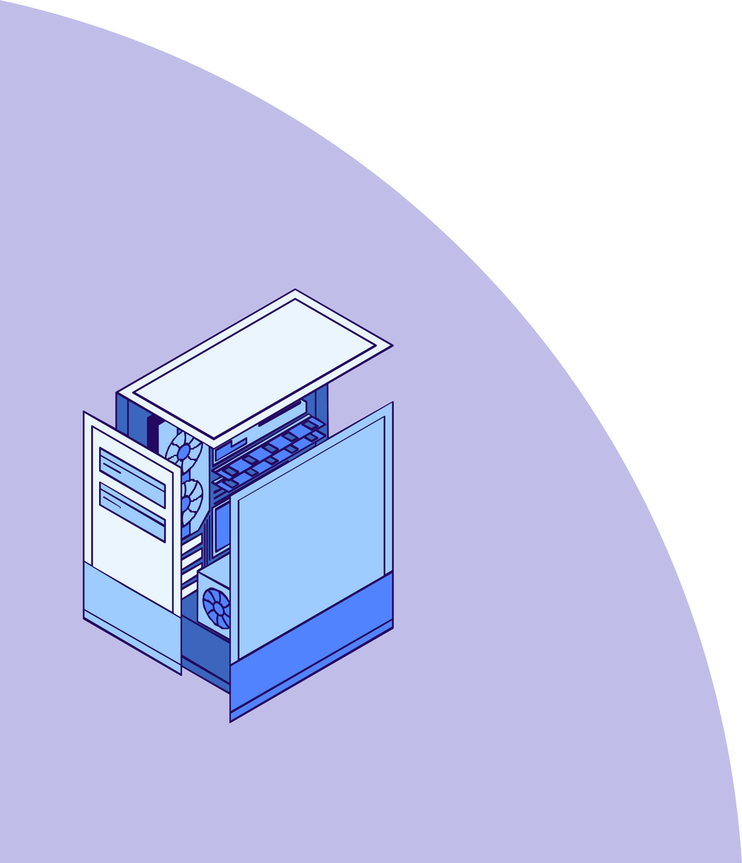

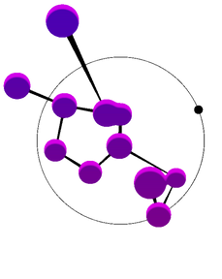

AGENDA
Problem Statement
Project Overview
End Users
Tools and Technologies 5.Portfolio design and Layout
6.Features and Functionality
7.Results and Screenshots 8.Conclusion
9.Github Link

Slide 3





Lack of interactive & modern portfolios for students/freshers.
Traditional resumes don’t showcase live projects effectively.
Need a responsive, dynamic portfolio to impress recruiters/clients.
PROBLEM
STATEMENT

Slide 4




PROJECT OVERVIEW
A single-page portfolio website built with React & Bootstrap.
Sections: About, Projects, Skills, Experience, Contact.
Features smooth scrolling, responsive layout, reusable components.

Slide 5







END USERS
Students/Fresh Graduates
Freelancers
Professionals (Developers, Designers, Photographers) Recruiters/Clients reviewing candidate profiles

Slide 6


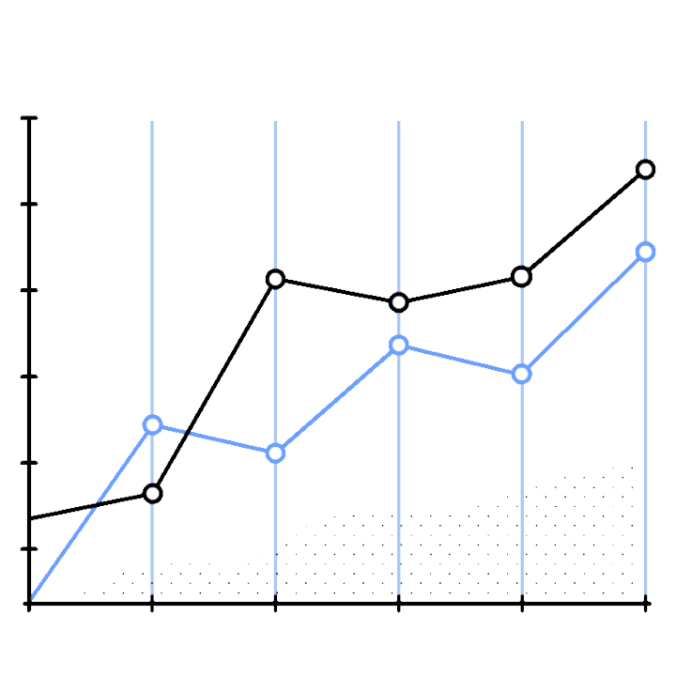

TOOLS &
Technologies
Frontend: React.js, Bootstrap, JavaScript, CSS
IDE: VS Code
Version Control: Git/GitHub
Hosting: Netlify / Vercel / GitHub Pages

Slide 7



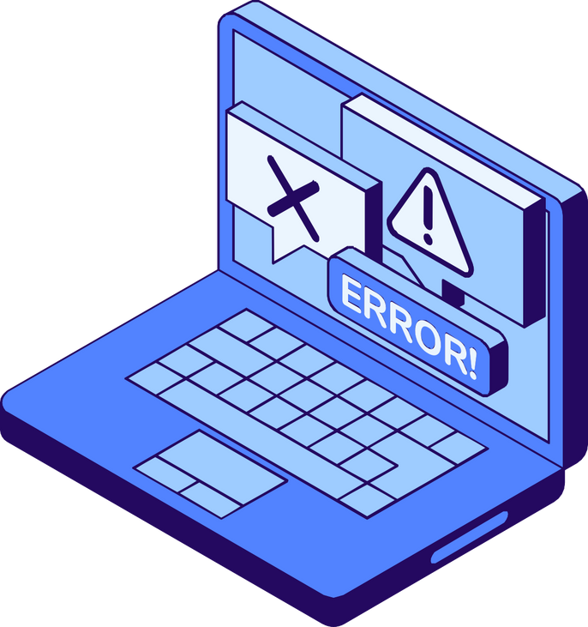


PORTFOLIO DESIGN AND LAYOUT
Navigation bar with smooth scroll.
Sections (Hero, About, Projects, Skills, Contact). Bootstrap grid system for responsive layout.
Consistent theme colors and typography.

Slide 8







FEATURES & FUNCTIONALITY
Single Page Application (SPA) structure.
Responsive across devices. Download Resume button.
Project showcase with images/links. Contact form with validation.
Social media integration.

Slide 9


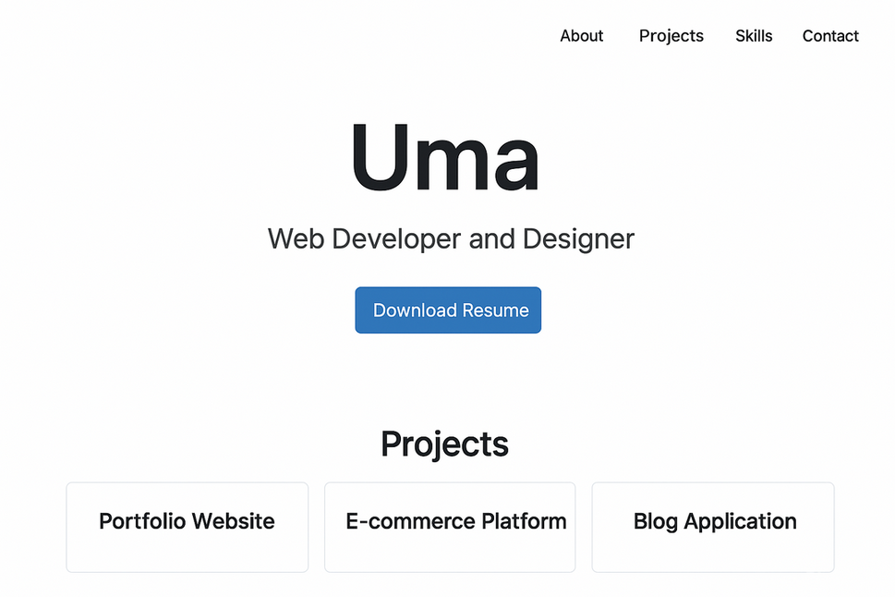
RESULTS AND SCREENSHOTS

Slide 10





Conclusion
Developed a modern portfolio with React & Bootstrap.
Showcases projects/skills effectively.
Useful for career building and freelancing opportunities.

Slide 11


GitHub Link
Source code of the project is uploaded to GitHub.
Publicly available for viewing and contribution.
Helps in version control & portfolio presentation
link:https://github.com/umamageshwaris-max/TNSDC-FWD-DP.git

Slide 12




THANK YOU!

